Slide 1
Practical on Decision Tree

Slide 2
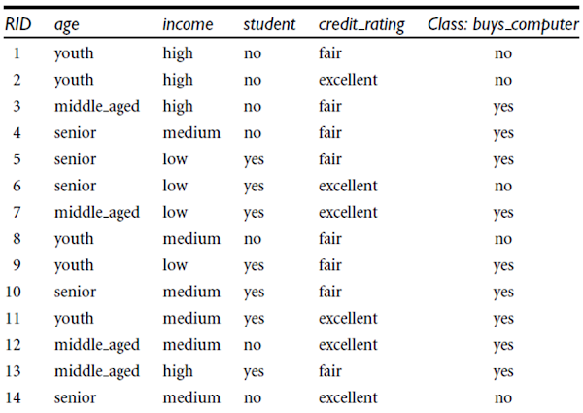
Toy Dataset: The problem and solution with a toy dataset are already well known.
This is a dataset that is available as part of the ML package itself such scikit-learn.
It is used to study a classification model such that it has a small size and has been used so extensively that might not have the case based relevance.

Slide 3
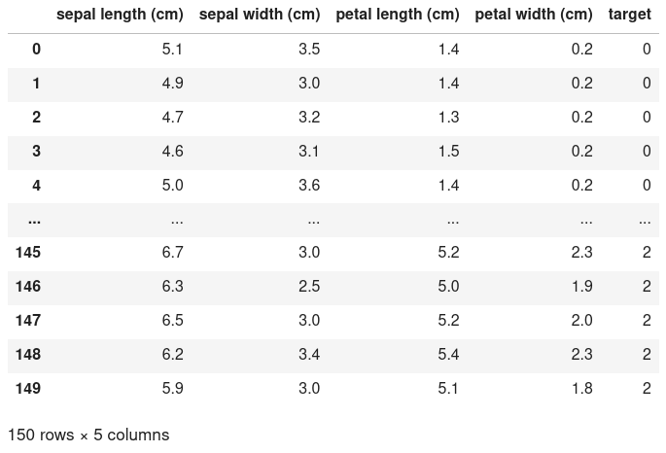
Iris Dataset For Studying Classification

Slide 4
Feature Variable and Target Variable
Feature Variable
Also known as:
* Independent Variables
* Knowns
* Attributes
Target Variable
Also known as:
* Dependent variable
* Unknown
* Label
A feature is something we have and know that we study in our research.
Aim of the research is to understand the target.
A decision tree (a supervised machine learning algorithm) uses historical data to learn patterns and uncover relationships between the features of your dataset and the target.

Slide 5
Problem
Question:
You are asked what is the rough estimate of the weight of the person whose height, age, gender you know.
What kind of problem is this: classification, clustering, or regression?
What will be your features and what will be your target?

Slide 6
Answer
Answer:
The problem is of regression.
Estimation of a real-valued valued number (weight).
Weight: target / dependent variable
Height, age, gender: are your features.

Slide 7
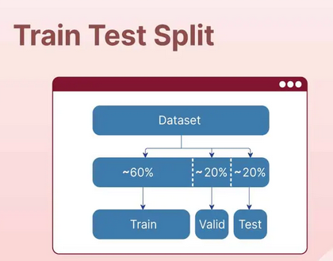
Splitting the data into train set and test set

Slide 8
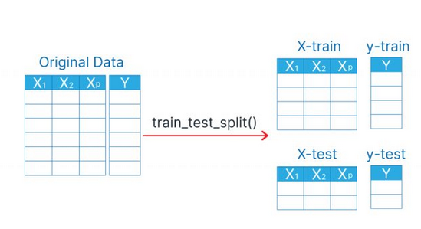
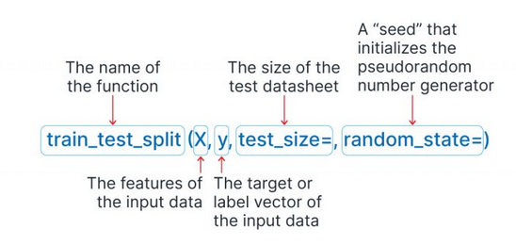

Slide 9
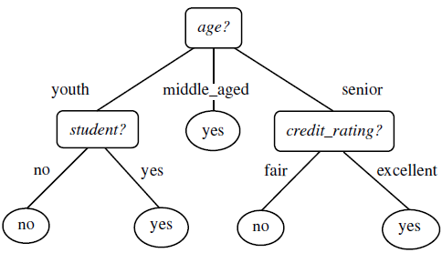
In a decision tree, we make decisions based on the attributes we study at the nodes (except leaf nodes).
As we move down from the root node (from top) to the bottom, we keep evaluting features (positioned at the nodes) for their values and decide whether we would like to go left or at the right down the tree.
At leaf nodes, we get to know what will be value of our target variable.

Slide 10
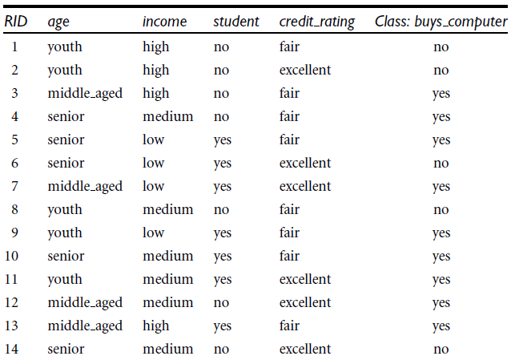

Attribute Selection Measures
Turn to slide 10: for solved problem

Slide 11

Attribute Selection Measures

Slide 12
Gini Index
Gini index measures the impurity of data, D.
Formula: Gini(D) = 1 – sum(p(i) ** 2)
Probability of event, E = # favorable outcomes / # sample space
buys_computer
1 no
2 no
3 yes
4 yes
5 yes
6 no
7 yes
8 no
9 yes
10 yes
11 yes
12 yes
13 yes
14 no

Slide 13
How many classes do we have?
Two classes.
p(no) = 5/14
p(yes) = 9/14
gini(D) = 1 – sum(p(i) ** 2)
= 1 - ( (5/14) ** 2 + (9/14) ** 2 )
= 0.4591836734693877

Slide 14
attr
alpha
alpha
alpha
alpha
alpha
alpha
alpha
alpha
alpha
alpha
Gini impurity is 0 when column contains single value throughout.
Gini = 1 – sum(p(i) ** 2)
p(i == alpha) = # alpha / # total
= 1
Gini = 1 – 1 = 0

Slide 15
In next couple slides, we will be introducing impurity in the otherwise ‘alpha’ valued column and see the gini impurity coefficient increase.
attr
alpha
alpha
alpha
alpha
alpha
alpha
alpha
alpha
alpha
beta
Gini = 1 – sum(p(i) ** 2)
>>> 1- ((9/10)**2 + (1/10)**2 )
0.17999999999999994

Slide 16
attr
alpha
alpha
alpha
alpha
alpha
alpha
alpha
alpha
beta
beta
Gini = 1 – sum(p(i) ** 2)
>>> 1- ((8/10)**2 + (2/10)**2 )
0.319999

Slide 17
attr
alpha
alpha
alpha
alpha
alpha
alpha
alpha
beta
beta
beta
Gini = 1 – sum(p(i) ** 2)
>>> 1- ((7/10)**2 + (3/10)**2 )
0.42000000

Slide 18
attr
alpha
alpha
alpha
alpha
alpha
alpha
alpha
beta
beta
gamma
Gini = 1 – sum(p(i) ** 2)
>>> 1- ((7/10)**2 + (2/10)**2 + (1/10)**2)
0.460000000000

Slide 19
attr
alpha
alpha
alpha
alpha
alpha
beta
beta
beta
beta
beta
Gini = 1 – sum(p(i) ** 2)
>>> 1- ((5/10)**2 + (5/10)**2)
0.5

Slide 20
attr
alpha
beta
gamma
delta
epsilon
zeta
eta
theta
iota
kappa
Gini = 1 – sum(p(i) ** 2)
>>> 1- ((1/10)**2 * 10)
0.9

Slide 21
If we want to split on age: what will be the gini index?
Gini(split Data on Attribute age) = sum(p(age == ?) * Gini for Data(age == ?))
= p(age == youth) * Gini for Data(attr == youth)
+ p(age == middle_aged) * Gini for Data(attr == middle_aged)
+ p(age == seniod) * Gini for Data(attr == senior)

Slide 22
If we want to split on student: what will be the gini index?
Gini(split Data on Attribute attr) = sum(p(Data(attr)) * Gini (Data(attr)))
= p(Data(student == yes)) * Gini(Data(student == yes))
+ p(Data(student == no)) * Gini(Data(student == no))

Slide 23
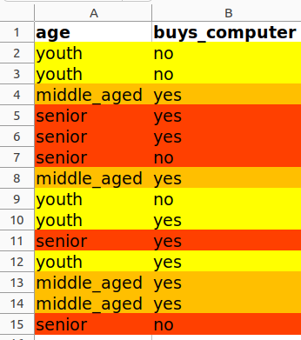
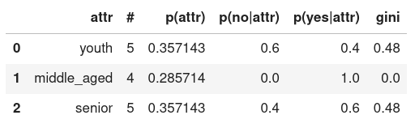
For records where age == youth:
These are yellow records.
p(yes | age == youth) = # yes / (# yes + # no)
# yes | age == youth = 2
# no | age == youth = 3
# yes / # total = 2 / 5 = 0.4
# no / # total = 3 / 5 = 0.6

Slide 24
Gini (age == youth) = ?
# yes = 2
# no = 3
Gini (age == youth) = 1 - ((2/5) ** 2 + (3/5) ** 2) = 0.48

Slide 25
For records where age == middle_aged:
These are orange records.
p(yes | age == middle_aged) = # yes / # total
# yes | age == middle_aged = 4
# no | age == middle_aged = 0
# yes / # total = 4 / 4 = 1
# no / # total = 0 / 4 = 0
Gini impurity is 0 when column contains single value throughout.

Slide 26
Algorithm for building a decision tree:
Step 1: Find overall gini coefficient. If the gini is zero. Stop the branching at this node.
Step 2: Find the attribute with which lowest gini impurity is left.
Step 3: Split on that attribute
Step 4: Repeat steps 1 to 3 to create more branches on splitted data.

Slide 27
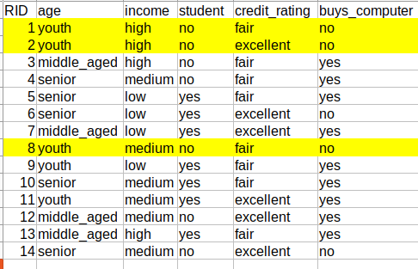
1: age == middle_aged or not
2: If true: buys computer
3: If false. Split.
Student == ‘no’: True or False.
4: If true: split on age.
Age == senior or not
5: If false:
Condition: not a student
And (not middle_aged and not senior)
Result: does not buy a computer

Slide 28
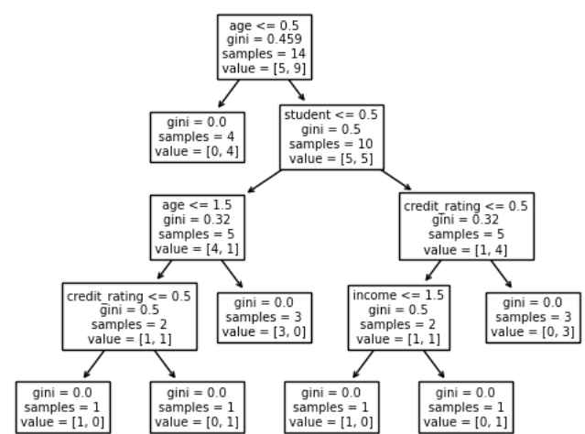
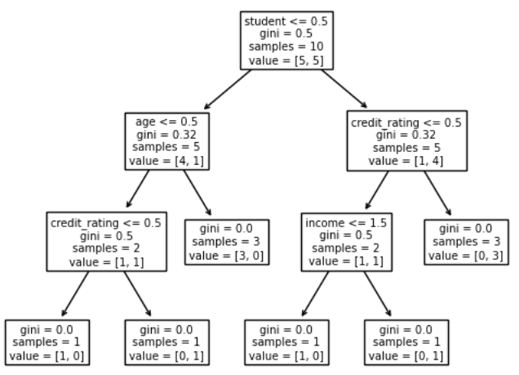
We split on age and on the right you are seeing the decision that we have yet to build.
age == middle_aged
age != middle_aged
age != middle_aged

Slide 29
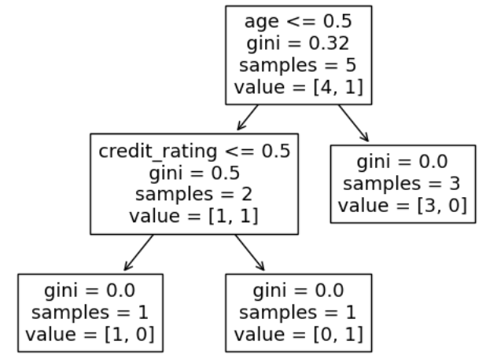
After we split on student and we are left building the following decision tree on the left branch.

Slide 30
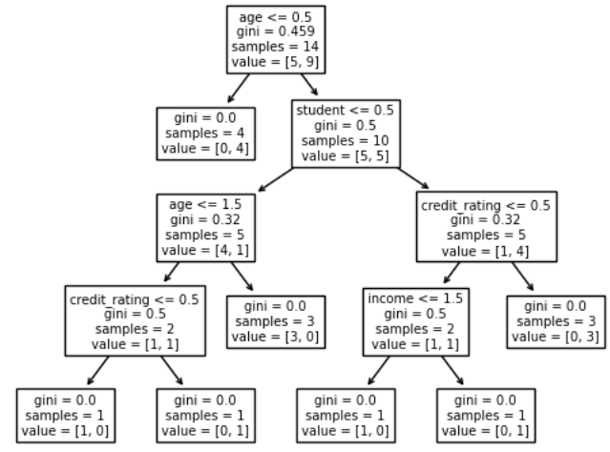
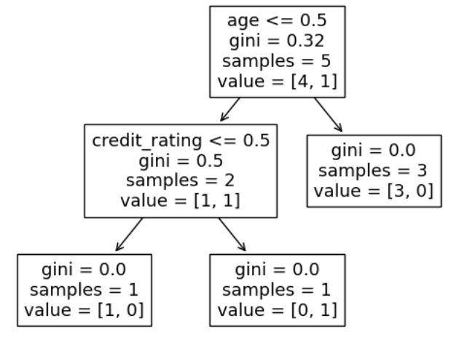
After we split on student and we are left building the following decision tree on the right branch.

Slide 31
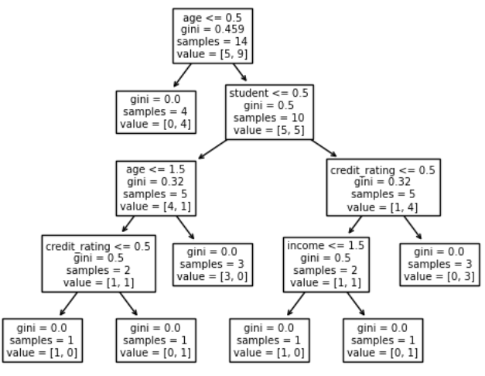
Record: (
Age == youth | 2,
Income == high | 0,
Student == no | 0,
Credit_rating == fair | 1
)
Checks age <= 0.5 == False
Checks student <= 0.5 == True
Check age <= 1.5 == False
We get [3 (no’s), 0 (yes’s)]

Slide 32
